Slide 1
Local Civic Issue Reporting Tool
CAPSTONE PROJECT
(Submitted in partial fulfillment of the Summer Internship on Full Stack Web Development, 2025)
Presented By Lokesh Jilakara
CSE
SRM UNIVERSITY-AP

Slide 2
OUTLINE
Problem Statement (Should not include solution)
System Architecture & Technology Stack
Database Schema & API Design
Implementation & Key Features
Deployment & Live Demonstration
Results
Conclusion
Future Scope
References

Slide 3
Problem Statement
A lot of people deal with civic issues like potholes, litter, and broken streetlights, others
They may have no way of knowing how to report these issues or to whom they can report them. Existing mechanisms are slow and they provide little transparency. Citizens rarely receive acknowledgement or feedback about their reported issues.
This need not be the case since these issues have a simple accessible solution to fix the disconnect.

Slide 4
System Architecture
The project uses a client-server setup. The frontend is built with HTML, CSS, and JavaScript, creating an interactive user interface. The backend runs on Node.js with Express.js, handling routing, APIs, and server logic. MongoDB stores user data, issue reports, and authentication details. The application follows a RESTful approach with modular routing.

Slide 5
Technology Stack
Frontend: HTML, CSS, JavaScript
Backend: Node.js, Express.js
Database: MongoDB
Deployment: Render
Version Control: Git + GitHub.

Slide 6
Database Schema & API Design
Database Schema:
Users Collection: Stores user details such as name, email, password (hashed), and more.
Issues Collection: Stores issue title, description, image, location, status, and user reference.
API Design:
POST /signup, User registration
POST /login, User authentication
POST /report, Submit a new issue
GET /issues, View all submitted issues
GET /profile, View user profile
DELETE /issue/:id, Remove an issue

Slide 7
Implementation & Key Features
User Authentication: Login and signup features with field validation.
Issue Reporting: Users can report civic problems by providing a description, location, and uploading images using Multer.
Dashboard: Shows reported issues and user activities.
Profile Page: Displays user details and their submitted issues.
Navigation Bar: A fully responsive navbar that provides access to all pages.
Contact & Help: Contains support email and contact number.

Slide 8
Deployment & Live Demonstration
Project is deployed using Render for easy live hosting.
Render automatically pulls the latest code from the GitHub main branch.
All dependencies, such as express, mongoose, multer, and others, are managed through package.json.
GitHub serves as the platform for version control, team collaboration, and issue tracking.
After a successful deployment, a live URL is created for public testing and demos.
Users can access key features like reporting issues, profile, and dashboard through the live link.
Live link: https://local-civic-issue-4.onrender.com

Slide 9
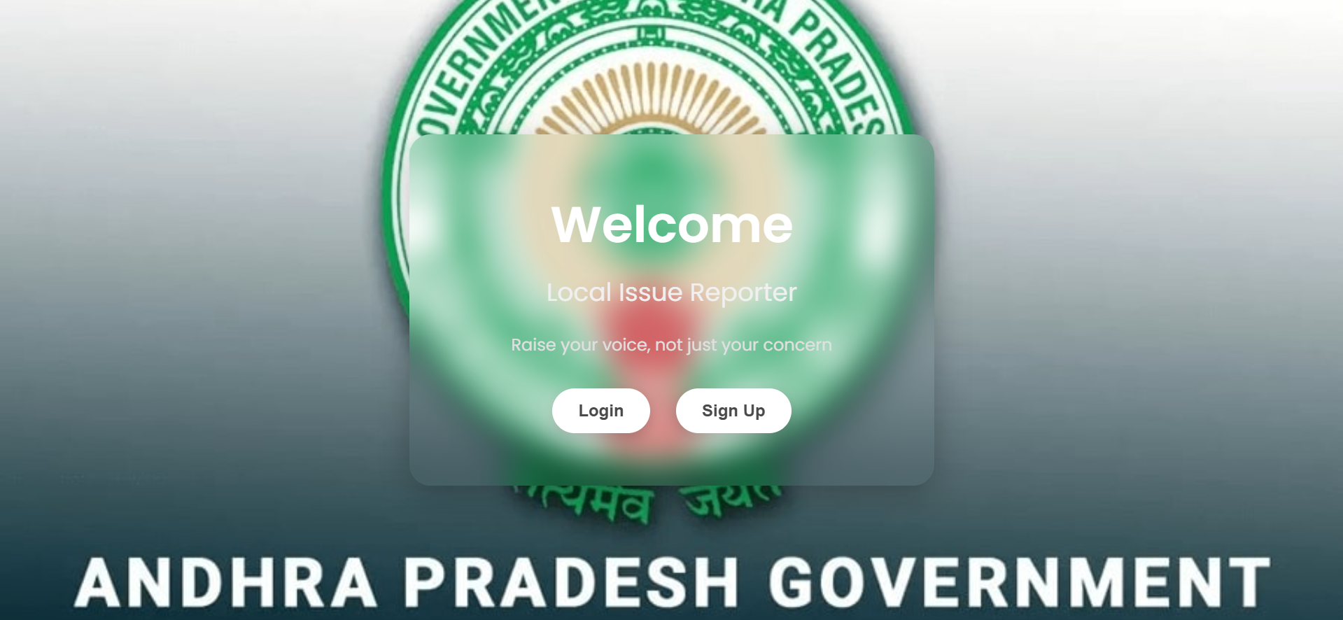
Results
Index Page

Slide 10
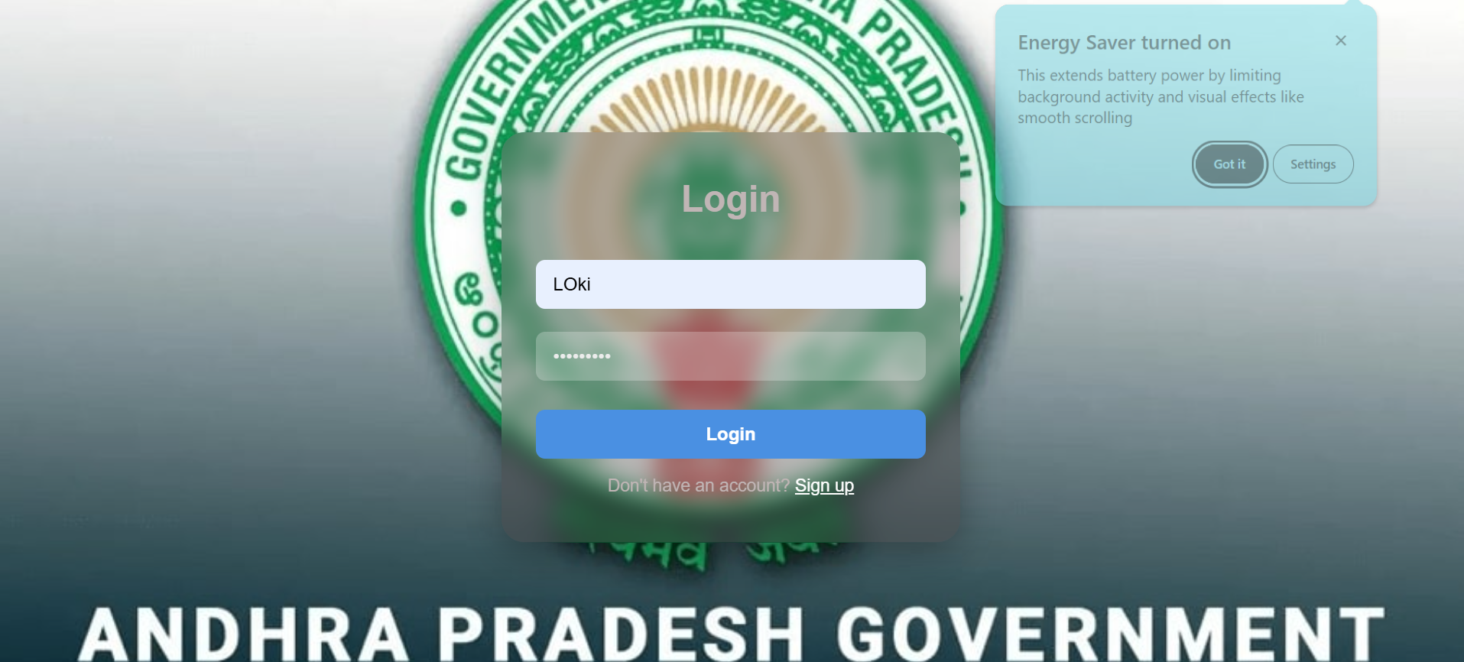
Login Page

Slide 11
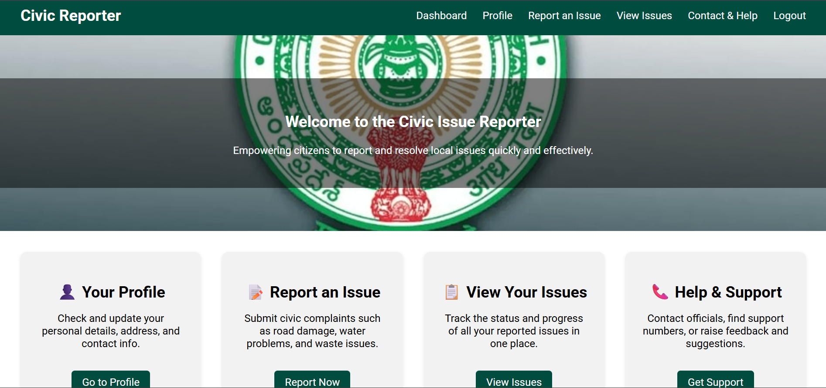
App Interface

Slide 12
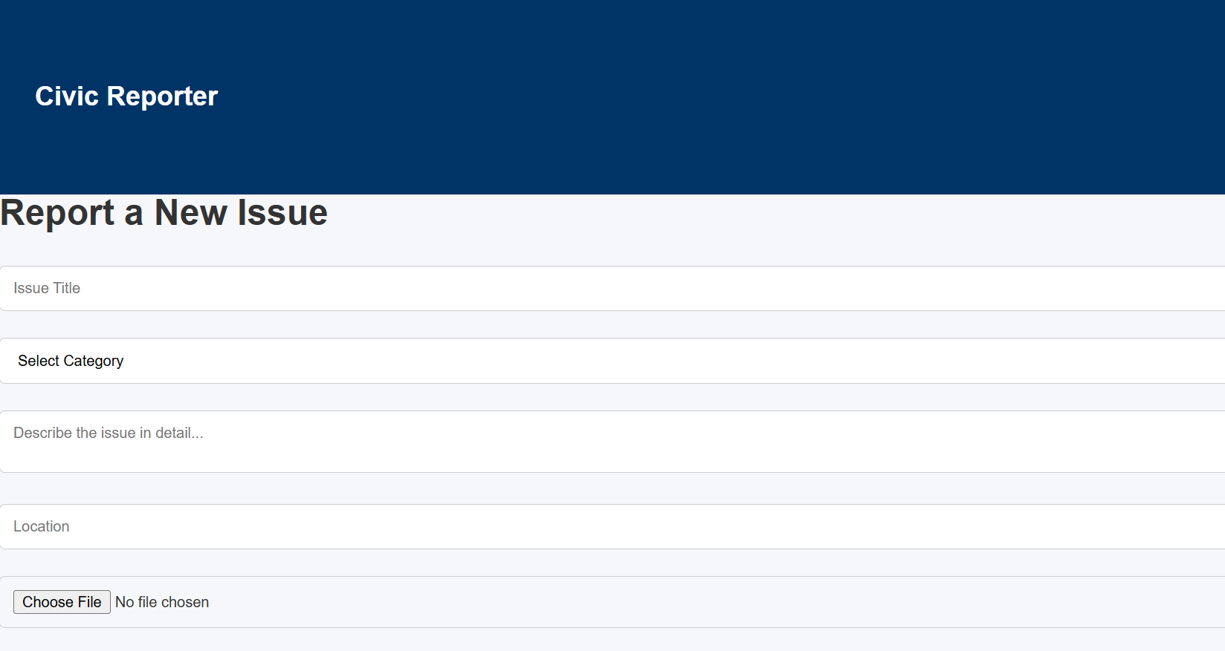
Reporting Page

Slide 13
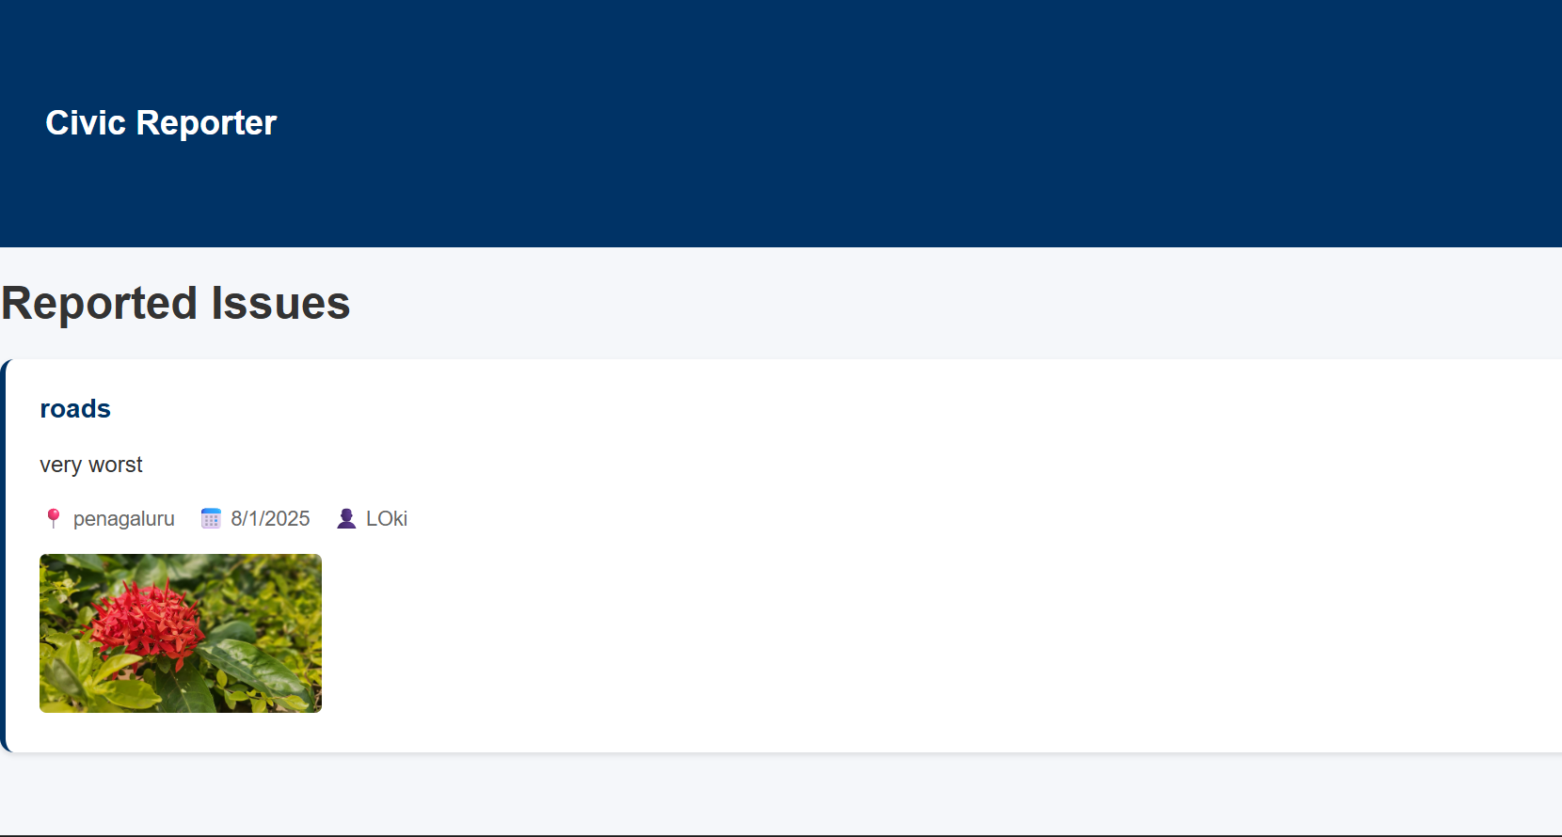
Issue Reported Page

Slide 14
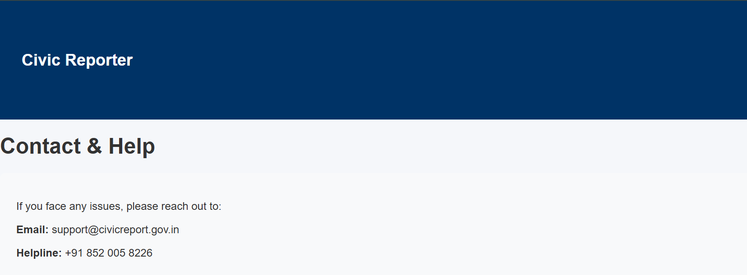
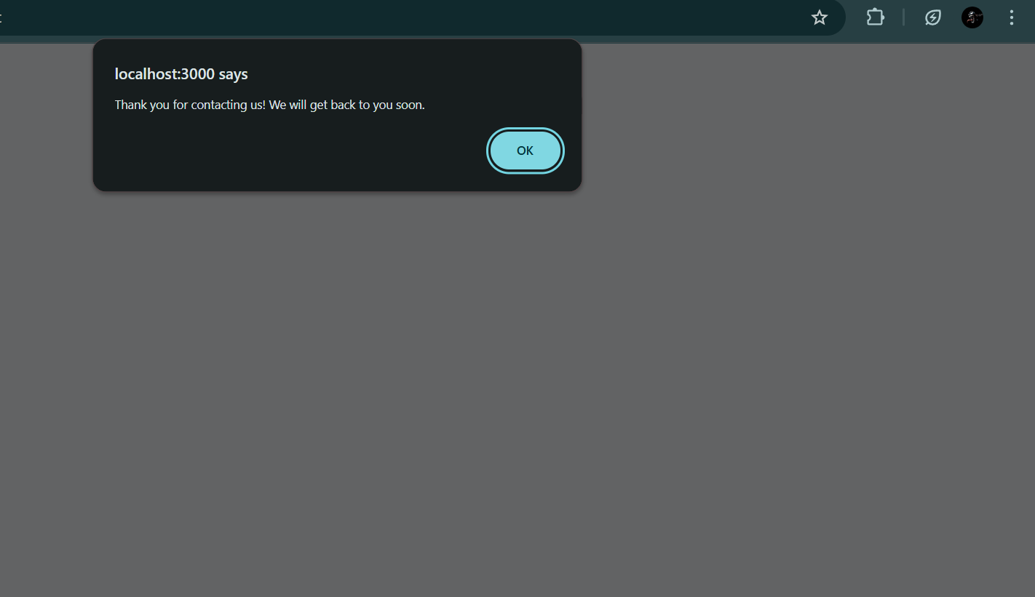
Contact & Help
Github link: https://github.com/lokeshjilakara-527/CIVIC-ISSUE

Slide 15
Conclusion
Full-stack web app for citizens to report local civic issues.
It uses Node.js, Express.js, and MongoDB for the backend and data handling.
The frontend is built with HTML, CSS, and JavaScript for a clean UI.
It is deployed live on Render with GitHub integration.

Slide 16
Future scope
Implement Admin Panel to check, update, or close issues.
SMS/Email alerts to authorities and users.
Map-oriented location picker with the Google Maps API.
AI-enabled auto-categorization of issues - road issues, drainage, electricity, etc.
Mobile app version with React Native..

Slide 17
References
Node.js Documentation – Backend server and async management.
Express.js Documentation – Routing and middleware configuration.
MongoDB & Mongoose – Database schema and queries.
Render Documentation – Hosting and deployment configuration.
MDN Web Docs – HTML, CSS and JavaScript reference.
freeCodeCamp – Full stack tutorials and examples.
YouTube tutorials on Node & MongoDB.
GitHub – Version control and project collaboration.

Slide 18
THANK YOU

